Slide 1
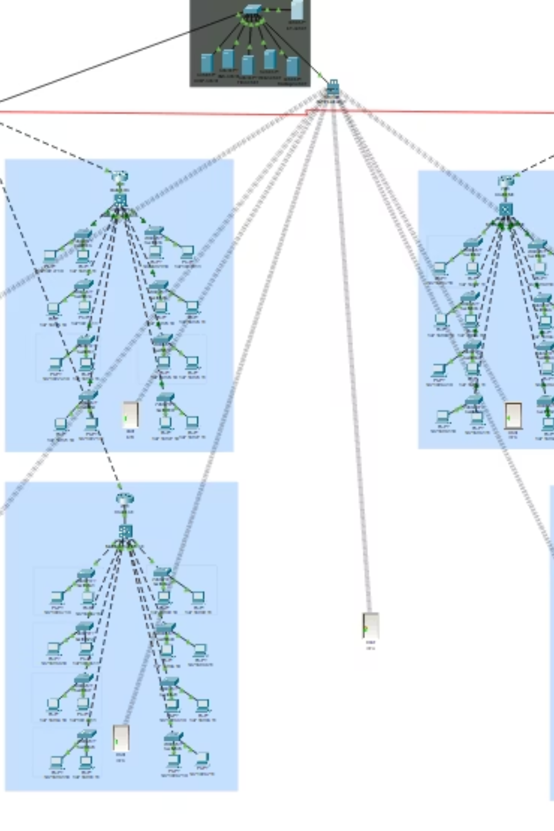

Bahria University Wah Smart Campus: IoT & Network Infrastructure
This presentation details the sophisticated network and IoT infrastructure designed for a modern smart campus, focusing on connectivity, security, and smart automation.
Group Members:
Chaudhary Muhammad Abubakar
Submitted To: Ma'am Purva Bashir & Adil Ali Raja.
Section: 4A

Slide 2
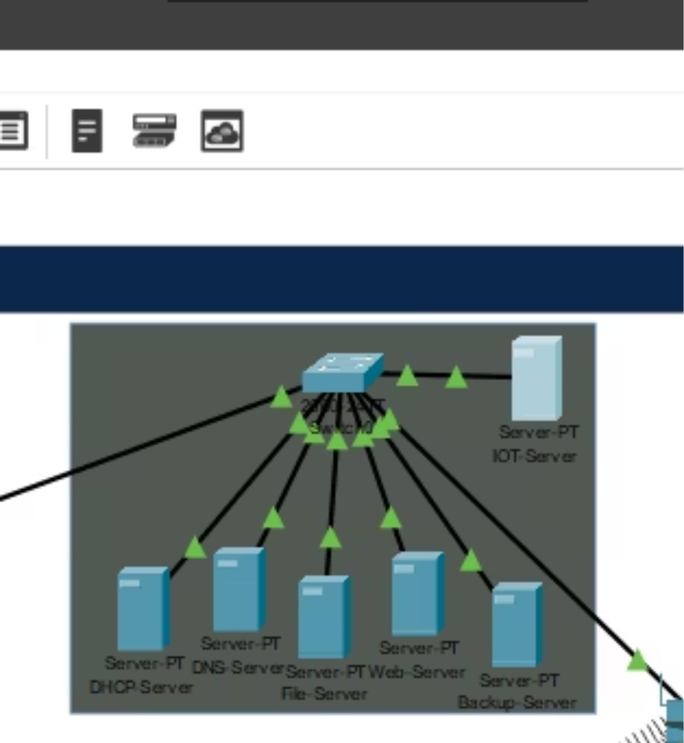
Robust Network Backbone and Core Services
Our smart campus network is built on a resilient OSPF backbone, ensuring high availability and efficient routing across all campus segments. This robust foundation supports critical services and seamless data flow.
DHCP Server
DNS Server
Automated IP address assignment for network devices.
Reliable domain name resolution for all campus services.
IoT Server
Centralized management and data processing for all IoT devices.

Slide 3
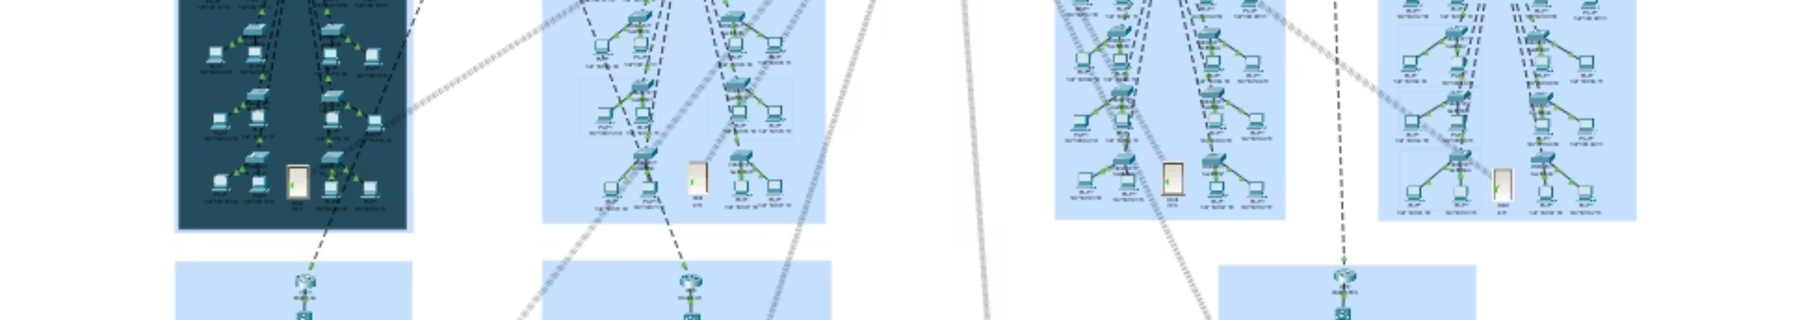
Seamless IoT Integration: Smart Doors Across Campus
Wireless Smart Doors
Home Gateway Bridge
Distributed Control
Implementing smart door technology for enhanced security and access control across 7 distinct lab blocks. These doors operate wirelessly, minimizing complex cabling.
A dedicated Home Gateway in each lab block acts as the crucial bridge, translating wireless signals from smart doors into the main network, ensuring reliable communication.
This distributed gateway approach minimizes single points of failure and optimizes local network traffic, enhancing overall system responsiveness.

Slide 4
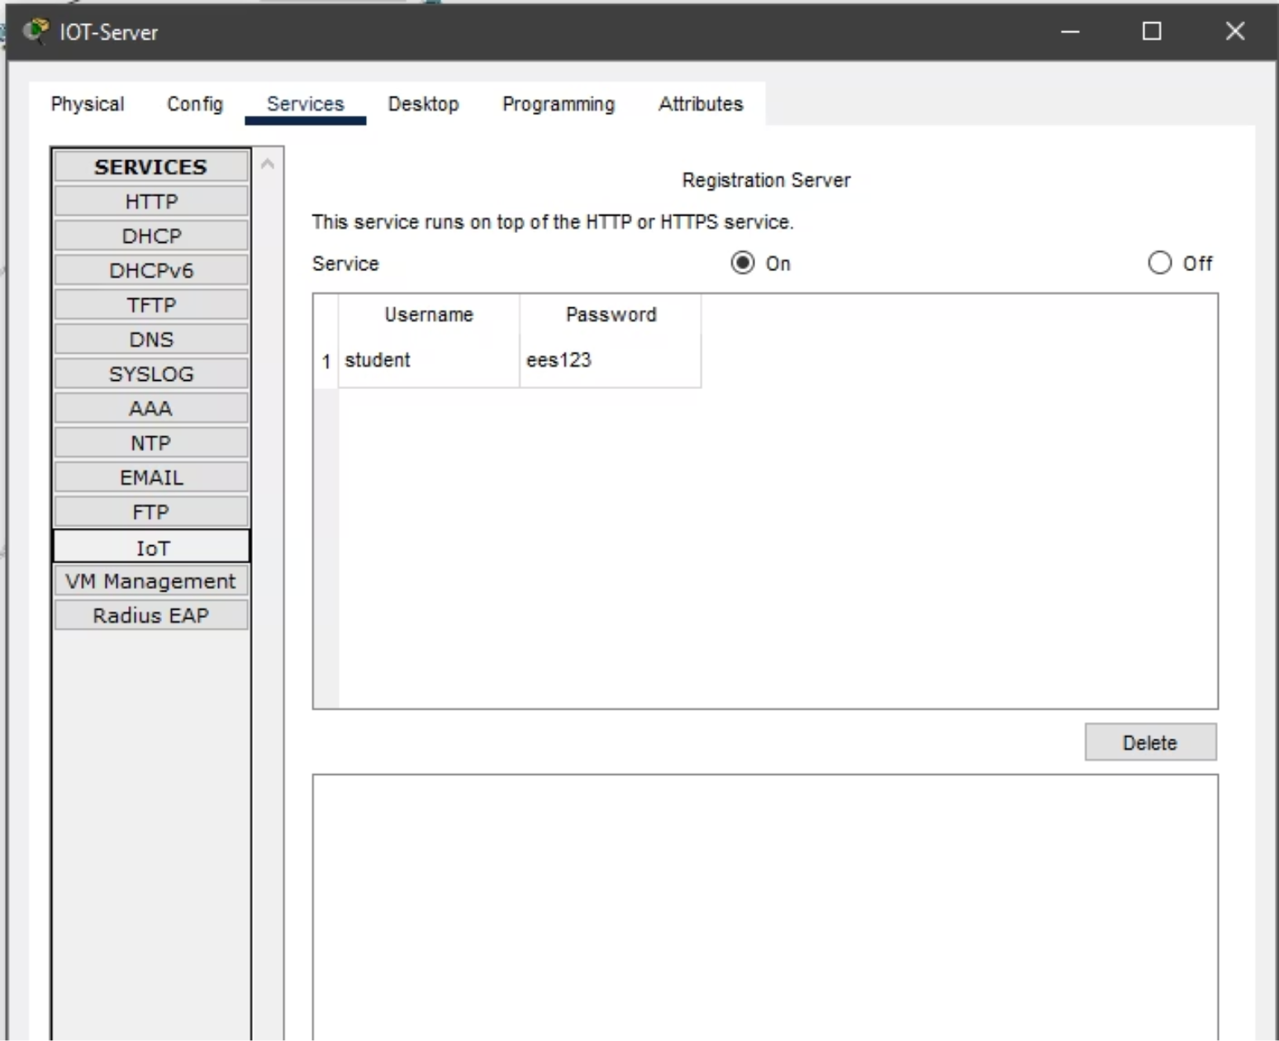
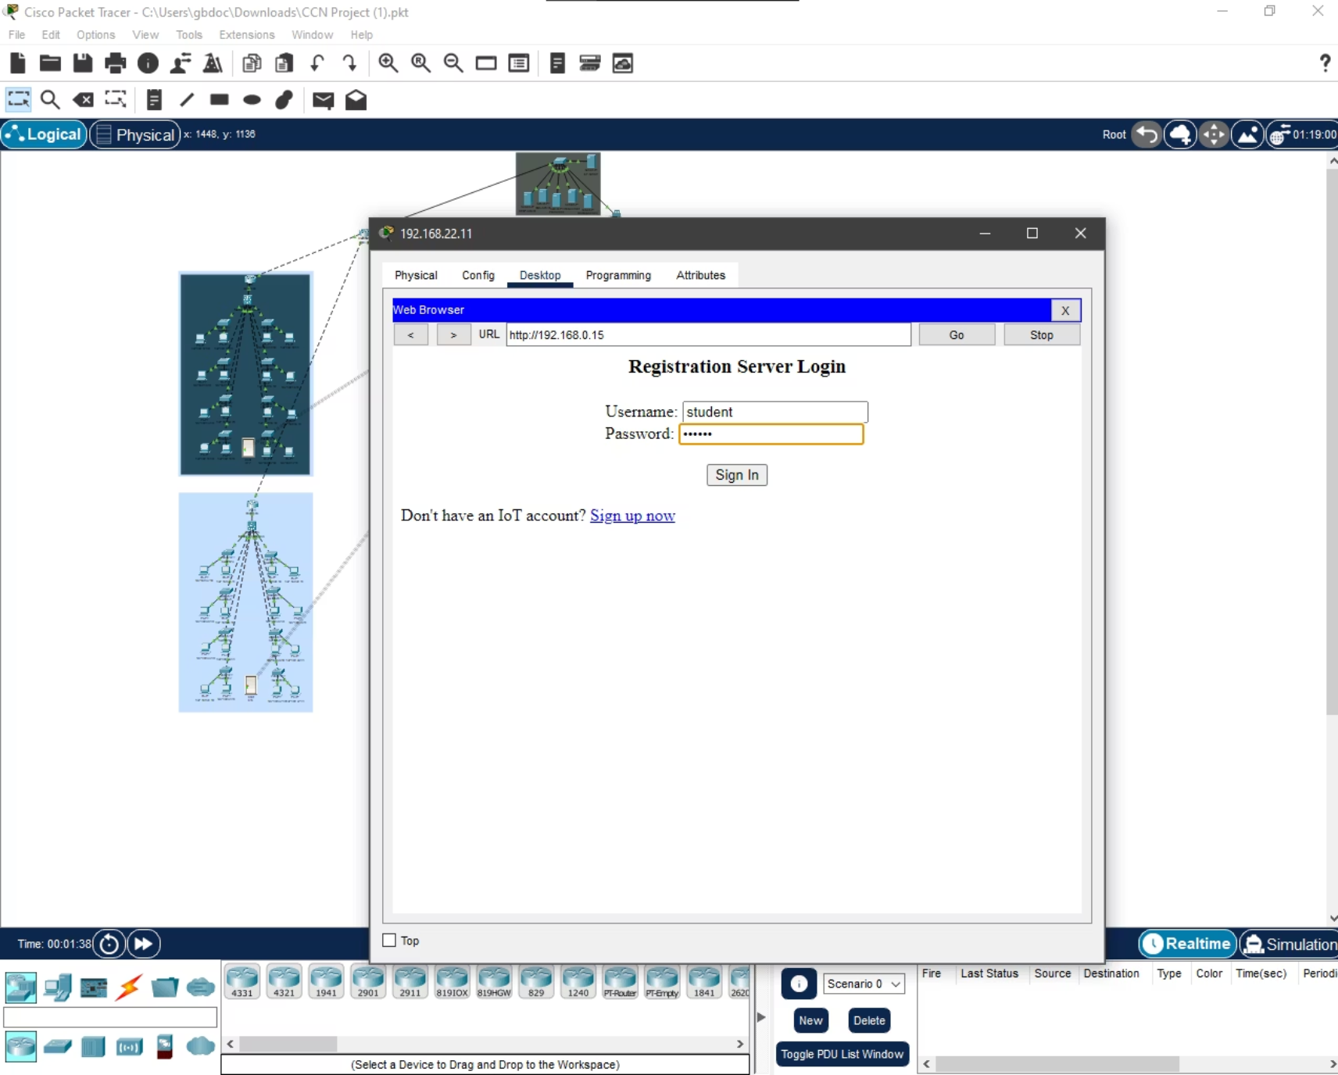
Dedicated IoT Security & Smart Automation
IoT Registration Server (192.168.0.15)
Web Dashboard for Remote Control
A dedicated IoT Registration Server ensures all devices are securely
authenticated and provisioned. This separation from the general
web server significantly mitigates potential security risks by isolating
critical IoT data and control functions.
A user-friendly web dashboard provides real-time monitoring and remote control of all lab doors. Utilizing a 'Thing Editor' logic with digital slots, users can easily view door status and issue commands, streamlining operational management.

Slide 5
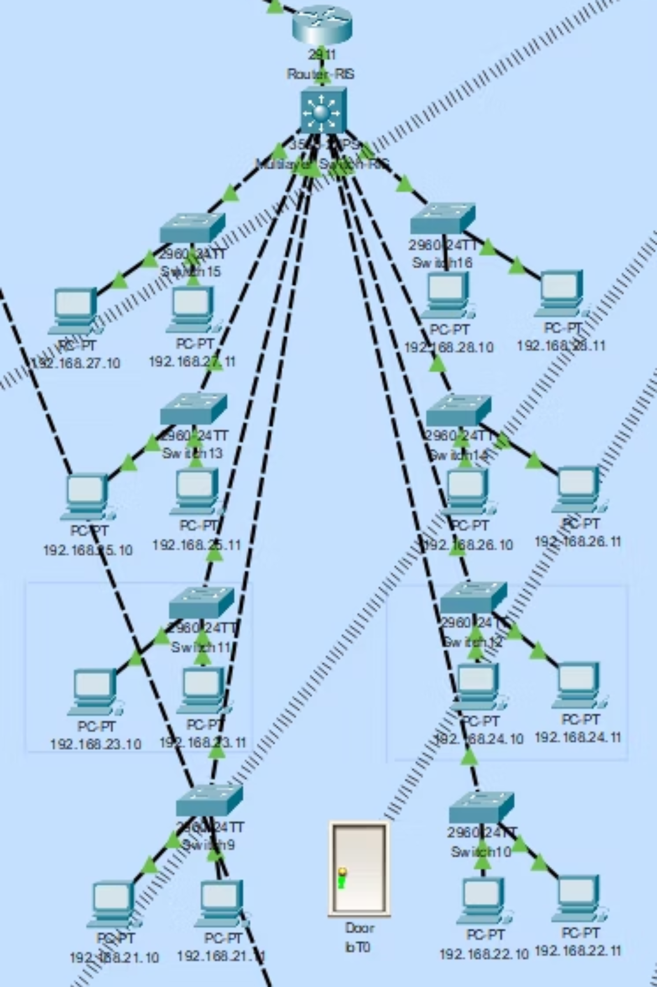



Scalability, Security, and Centralized Management
Scalable Design
The modular architecture allows for easy expansion, accommodating future growth in IoT devices and campus infrastructure without significant overhaul.
Enhanced Security
Dedicated servers and isolated networks provide robust protection against cyber threats, safeguarding sensitive campus data and access controls.
Centralized Control
A unified management platform offers comprehensive oversight and simplified operation of the entire smart campus ecosystem, from network to devices.
This integrated approach delivers a secure, efficient, and future-proof smart campus environment, leveraging cutting-edge IoT and networking principles.

